Slide 1
High availability on SQL Server
By Alain Philip Despont

Slide 2
High availability, what is it ?
It’s assuring a service stay available even in case of a failure, and with the least damage possible.
This can be a hardware solution : clustering, load balancing, raid arrays.
A software solution : synchronous and asynchronous replication
In all case it’s a strategic decision :
Example in a supermarket, it’s the printer and cash register service who is always available. In a bank, the ATM, account data and money transfer.

Slide 3
SQL Server what is it ?
It’s a Relational Database Management System
A database goal is to store data in a table
Those tables are linked together with a key (relationship)
Example :
client_info
ID (PrimaryKey) | Lastname | Firstname | Age | Adresse
987 | Dugarni | Jean | 49 | Chemin du rat 3
client_command
Client_ID (PrimaryKey) | Command_ID
987 | 093840549858
command_info
ID(PrimaryKey) | Product
093840549858 | Fish and chips

Slide 4
Functionning of a SQL Server transaction
A client emit one or more SQL requests to get, or create, modify data
Example : SELECT Adresse, City, Phone FROM Student_info WHERE Firstname = Jean
SQL Server execute the TRANSACTION (multiple SQL request can be part of one transaction)
The transaction is a unity of work to do.
SQL Server do only one transaction at a time
The transaction can make lot of change in the same time
TRANSACT SQL is used to write SQL with sequences and pauses (START/GO)
Important principle : atomicity
SQL Server verify atomicity of the transaction: if there is an error, it must be able to get back to the precedent state, not «in between».
Data is written, else it isnt written
Will explain ACID at the end…

Slide 5
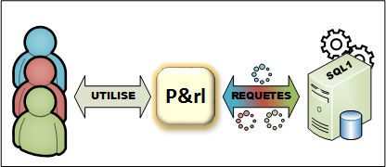
P&RL case
P&rl is a service business who find a student to execute some work (like going out with the dog).
P&rl has an mobile application who connect to an autonomous SQL Server
Pe&rl has too many simultaneous people consulting or book services and ask for a high availability solution.
Use
Requests

Slide 6
High availability solution from SQL Server
Based on the Windows Server «Failover clustering» functionnality
Is integrated to SQL Server 2021 and later
Permit database replication between servers
Permit load-balancing (read-only request or write dispatched between servers).
Give one accesspoint for external applications
PASSIVE-ACTIVE clustering (only on server write data, ACID…)

Slide 7
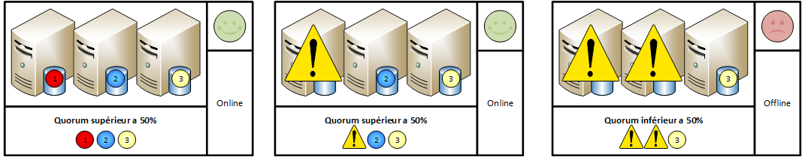
How work the Windows Failover Cluster
One node = one vote
If more than half the node are up, the cluster stay active
QUORUM GOAL : verify the majority of nodes are online…
Even nodes = need a witness (to pass power to the node)
Uneven nodes = No need for a witness but is advised

Slide 8
Once the failover cluster is created…
We can add again more SQL Server if we want
In the example : three SQL Servers
Servers need to have the same SQL Server and Windows versions…
We can now create an high-availability group in SQL Server !

Slide 9
SQL Server AlwaysOn Availability Groups
It’s an SQL Server specific failover cluster service, who lay on the failover cluster from Windows.
It assign roles to servers (primary, secondary)
It take note of wich database must be replicated
It take note of the assigned configuration for SQL requests (write only) for load-balancing

Slide 10
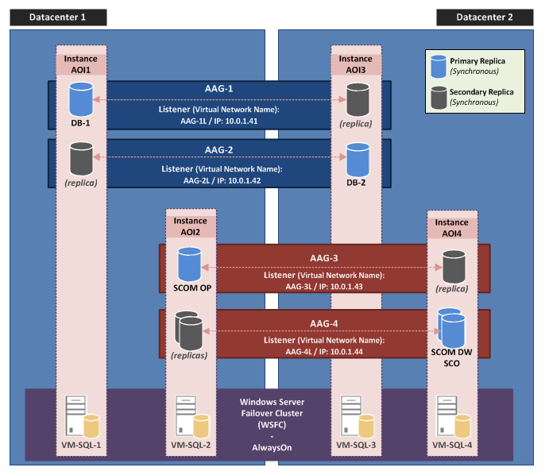
Example : datacenter replication
Application accesspoint
FAILURE

Slide 11
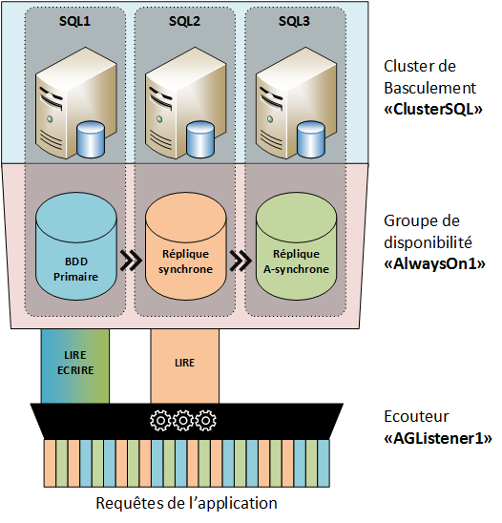
Cluster manage the computers… …the group manage the databases
Failover cluster
AlwaysOn
Disponibility Group
Primary database
Synchronous replica
ASynchronous replica

Slide 12
The listener can separate requests
AlwaysOn
Disponibility Group
Primary database
Synchronous replica
ASynchronous replica
Read
Write
Read
Only
Listener
Requests from the application

Slide 13
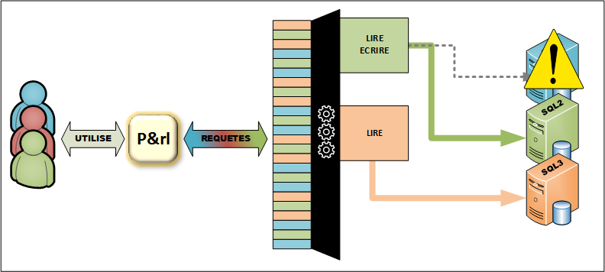
In case of failure of the primary node
Read
Write
Read
Only
Use
Requests

Slide 14
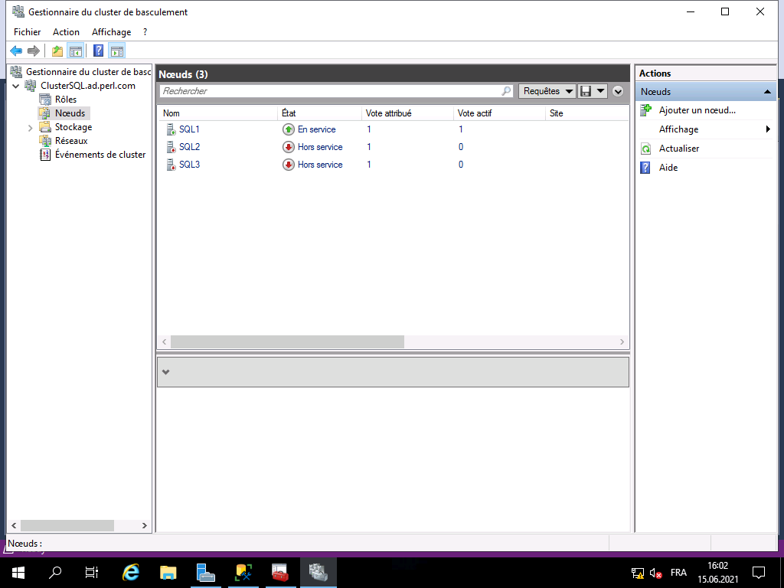
In practice…

Slide 15
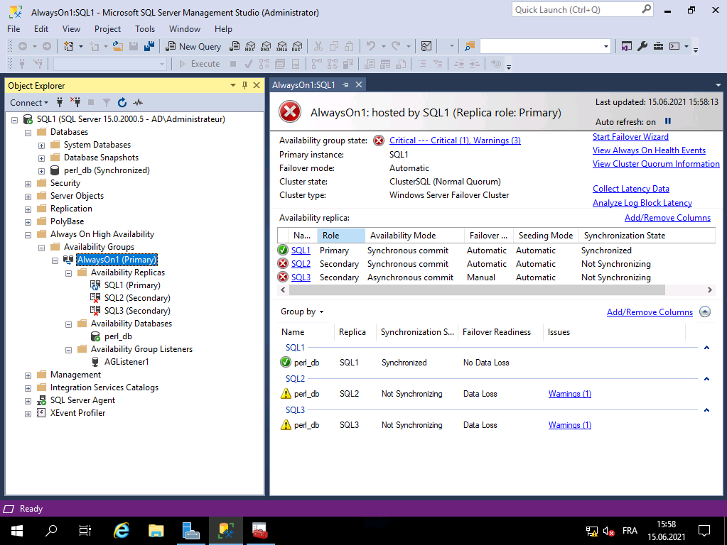

Slide 16
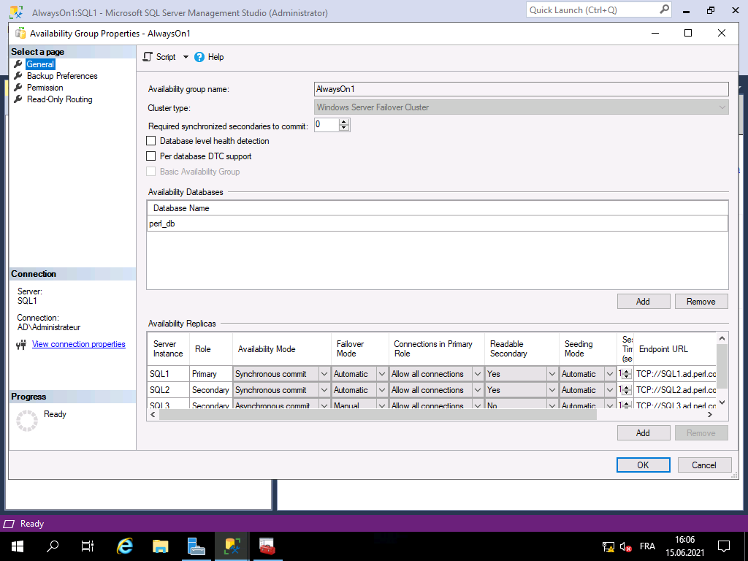

Slide 17
Dernières réflexions Last toughts
Backup should occur on the primary server to save the lasts changes (he’s the only to write), but it can occur on one of the secondaries.
Remember : no multiple «writes», SQL Server can’t handle writing on multiple servers because of the ACID principle : Atomicity, Consistency, Isolation, Durability.
Atomicity : la transaction se fait ou ne se fait pas. Atomicity : the transaction is made or isnt,
Consistency : ensures that a transaction can only bring the database from one valid state to another (Wiki)
Isolation : ensures that concurrent execution of transactions leaves the database in the same state that would have been obtained if the transactions were executed sequentially (Wiki)
Durability : guarantees that once a transaction has been committed, it will remain committed even in the case of a system failure
So, only one primary server execute transaction, the replicas can only be read.
Must think about the cluster when updating (shutdown a computer = node fail)
Oldest methods to get high availability on SQL Server (database replication, log shipping) are harder and less efficient ways than AlwaysOn availability groups that does eveything.

Slide 18
Merci de votre attention
BEGIN TRANSACTION
SELECT * questions FROM public
END;

